Slide 1


Android Application Development
Lecture 1(B): Getting Started
1. Developer Workflow
2. Introduction to Required Tools
3. Tools Download [SDK & IDE]
4. Setting up the Environment
5. Exploring the Tools
6. Getting Started: Hello World
7. Running a Project
8. Project Structure
Ahsanul Karim
karim.ahsanul@gmail.com
http://droidtraining.wordpress.com

Slide 2

Getting Started
In This Session, We'll Discuss...
1. Developer Workflow
2. Introduction to Required Tools
3. System Requirements
4. Tools Download [SDK & IDE]
5. Setting up the Environment
6. Exploring the Tools
7. Getting Started: Hello World
8. Running a Project
9. Project Structure

Slide 3
Getting Started
Developer Workflow [1]
Setup
Set up your Development Environment
Install the Android SDK, Android Development Tools, and Android platforms.
Set up AVDs and Devices for Testing
Create Android Virtual Devices and Connect hardware devices that will be used for testing
Development
Create your Application
Create an Android project with your Source code, resources and Android manifest file

Slide 4
Getting Started
Developer Workflow [2]
Debugging and Testing
Build and Run your Application
Build and Run your application in Debug mode
Debug your Application
Debug your application using the Android debugging and logging tools
Test your Application
Test your application using the Android testing and instrumentation framework

Slide 5
Getting Started
Developer Workflow [3]
Publishing
Prepare your Application for Release
Configure, build and test your application in release mode
Release your Application
Publicize, Sell and Distribute your application to users

Slide 6




Getting Started
Introduction to Tools [1]
1. Compiler: JDK 1.6+ [Java Development Kit]
2. IDE [Eclipse/IntelliJ IDEA]
3. Android SDK
4. ADT Plugin
Eclipse IDE
Android SDK
JDK
ADT Plugin

Slide 7
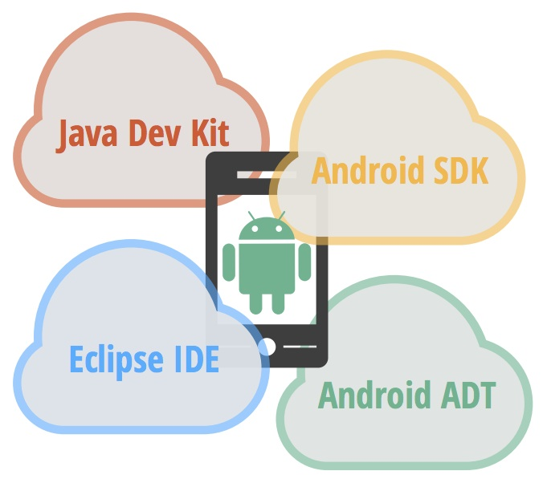
Getting Started
Introduction to Tools [2]

Slide 8
Getting Started
System Requirements...
Operating System :
Eclipse :
1. Windows
Windows XP (32-bit) Vista (32- or 64-bit), or Windows 7 (32- or 64-bit)
2. Mac
Mac OS X 10.5.8 or later (x86 only)
3. Linux (tested on Ubuntu Linux, Lucid Lynx)
GNU C Library (glibc) 2.7 or later is required.
On Ubuntu Linux, version 8.04 or later is required.
64-bit distributions must be capable of running 32-bit applications.
Eclipse 3.6.2 (Helios) or greater [Indigo will be used]
Eclipse 3.5 (Galileo) no longer supported with the latest version of ADT.
Java :
JDK 6 (JRE alone is not sufficient)

Slide 9

Getting Started
Introduction to Tools...
Eclipse IDE
ADT Plugin
Android SDK
ADT Bundle
intelliJ IDE
Android SDK
Plugin
JDK
Android Studio

Slide 10
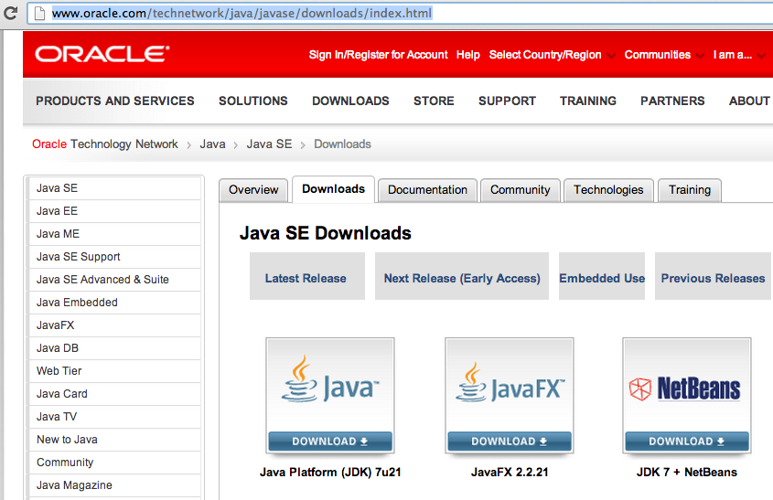
Getting Started
Tools Download...
Java [JDK 6]:
Download: http://www.oracle.com/technetwork/java/javase/downloads/index.html

Slide 11
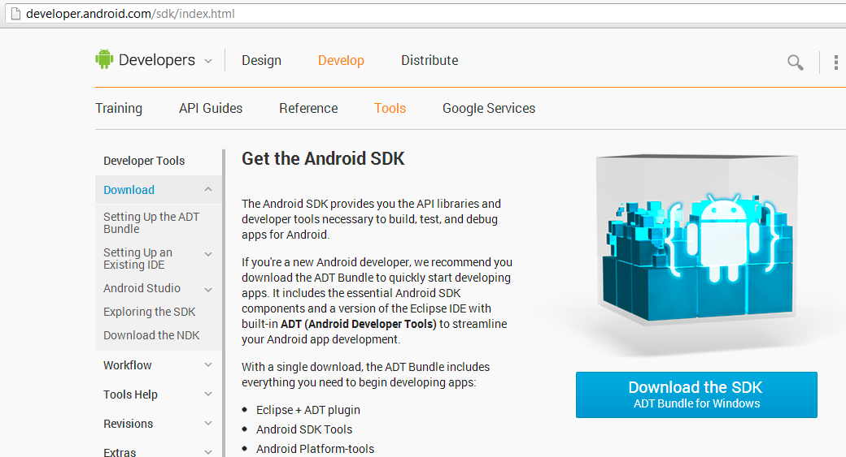
Getting Started
Tools Download...
ADT Bundle: [1]
Download: http://developer.android.com/sdk/index.html

Slide 12
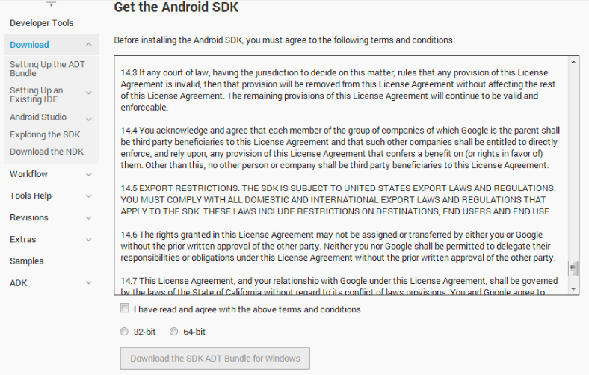
Getting Started
Tools Download...
ADT Bundle: [2]
Choose appropriate version

Slide 13
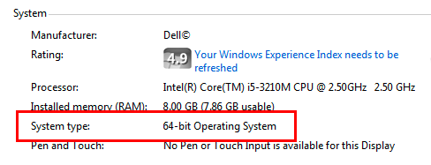
Getting Started
Tools Download...
ADT Bundle: [3]
Check OS version [32 bit/64 bit] and Download
So we'll download and use 64bit version of ADT Bundle

Slide 14
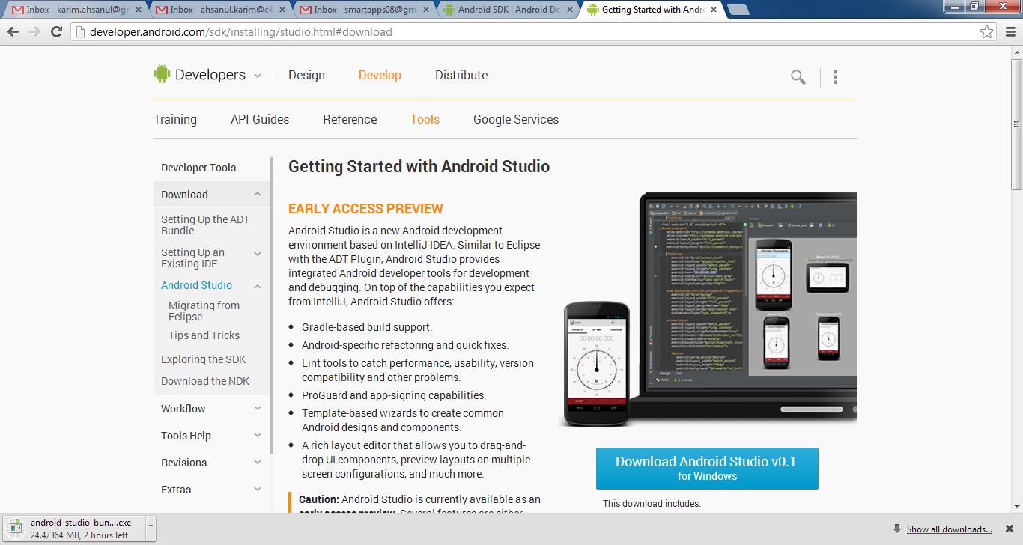
Getting Started
Tools Download...
Android Studio
Download: http://developer.android.com/sdk/installing/studio.html

Slide 15
Getting Started
Setting up Environment...
ADT Bundle
Unpack the ZIP file (named adt-bundle-<os_platform>.zip) and save it to an appropriate location, such as a "Development" directory.
Open the adt-bundle-<os_platform>/eclipse/ directory and launch eclipse.
Do not move any of the files or directories from the adt-bundle-<os_platform> directory. If you move the eclipse or sdk directory, ADT will not be able to locate the SDK and you'll need to manually update the ADT preferences.

Slide 16
Getting Started
Exploring the Tools...
1. Android SDK
a. AVD Manager
b. SDK Manager
c. DDMS
d. Emulator
2. Eclipse
a. Java Perspective
b. DDMS Perspective

Slide 17
Getting Started
Kickstart...
Creating New Project: Hello World
Running a Project
Project Structure

Slide 18
Getting Started
Questions...
Judge a man by his questions rather than his answers.
-Voltaire

